Slide 1








Chongqing University of Technology
ATAI
Advanced Technique of Artificial Intelligence
Chongqing University of Technology
More than Text: Multi-modal Chinese Word Segmentation
Dong Zhang, Zheng Hu, Shoushan Li, Hanqian Wu, Qiaoming Zhu, Guodong Zhou
School of Computer Science and Technology, Soochow University, China
School of Computer Science and Engineering, Southeast University, China
{dzhang, lishoushan, qmzhu, gdzhou}@suda.edu.cn
{zhenghu, hanqian}@seu.edu.cn
2021.10.10 • ChongQing
—— ACL2021
Reported by Changjiang Hu

Slide 2

Chongqing University of Technology
ATAI
Advanced Technique of Artificial Intelligence
Chongqing University of Technology
1.Introduction
2.Method
3.Experiments

Slide 3
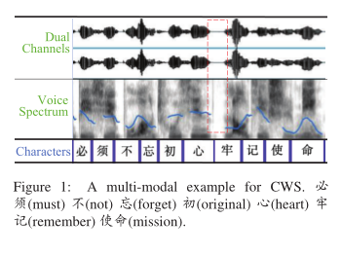
Introduction
Word segmentation is a fundamental task in Natural Language Processing (NLP) for those languages without word delimiters, e.g., Chinese and many other East Asian languages (Duan and Zhao, 2020). In this paper, we mainly take Chinese language as investigating object, namely CWS. As we know, CWS has been applied as an essential preprocessing step for many other NLP tasks (Zhou et al., 2019; Qiu et al., 2020), such as named entity recognition, sentiment analysis, machine translation, etc.
if we only read the text with no punctuation, it is not easy to make word segmentation immediately.
Therefore, in this paper, we propose to performing CWS with multi-modality, namely MCWS, by a time-dependent multi-modal interactive network.
Notes:
在对话系统中，对话行为识别和情感分类是两个相关任务，能够帮助进行识别说话者的意图。其中，对话行为能够展示说话者显式的意图，而情感能展现说话者隐式的意图 [1]。
更具体的来说，对话行为识别和对话情感分类都可以看作是分类任务，目标是将对话中的每条语句标注上对应的DA标签和SC标签。
直观上，有两个关键因素有助于对话行为识别和情感预测。一个是跨任务的相互交互信息mutual interaction information，另一个是对话中的上下文信息context information。
如图3所示，前人的联合建模工作中，Cerisara等人[1]专注于相互交互信息（图3左），Kim等人[2]专注于对话历史信息（图3右）。最近，Qin等人[3]提出DCR-Net模型，虽然取得了较好效果，但是该模型却是以一种pipeline的方式来获取两种信息：在Encoder端获取对话历史信息，在relation layer端获取交互信息。但是我们认为，该类流水线式的模型存在一个问题： 两种信息是单独建模的。
所以接下来的问题是： 我们是否可以在一个统一的框架中同时对相互交互信息和上下文信息建模，来将它们完全整合呢？

Slide 4
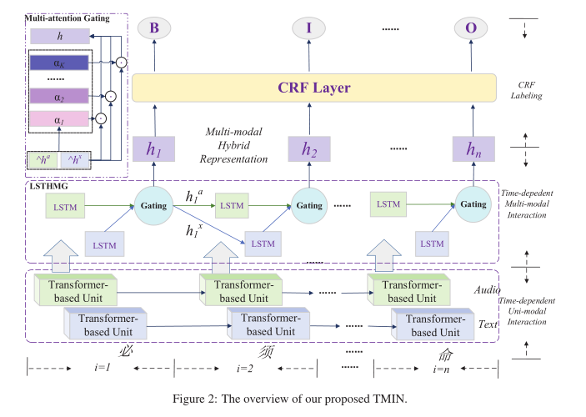
Method
Notes:
如图所示，这是模型的整体框架。由三部分组成，第一部分为分层对话者感知编码器；第二部分为核心模块——协同图交互层；第三部分为解码器部分。将在以下部分中作详细介绍。

Slide 5
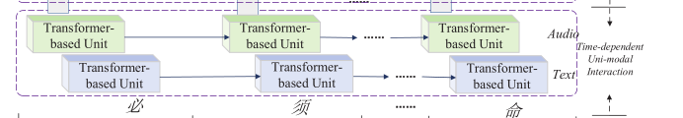
Method
Textual Modality:We use BERT as encoder to perform intra-modal interactions and obtain the contextual character representation.Then, each character of text transcripts can be represented as: X = (x1, x2, ··· , xn) ∈ R^(n×d1)
Acoustic Modality:We use a famous audio processing tool, i.e., OpenSMILE to extract the MFCC, LP-coefficients, pure FFT spectrum, etc. from dual channels and leverage multiple Transformer layers to perform intra-modal interactions. Then, each character-level audio feature can be represented as: A = (a1, a2, ··· , an) ∈ R^(n×d2 ).
Notes:
如图所示，这是模型的整体框架。由三部分组成，第一部分为分层对话者感知编码器；第二部分为核心模块——协同图交互层；第三部分为解码器部分。将在以下部分中作详细介绍。

Slide 6
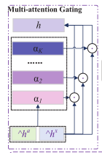



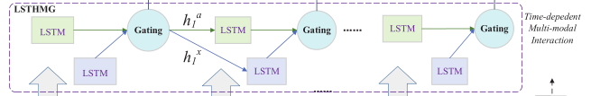
Method

Slide 7
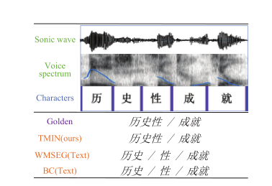
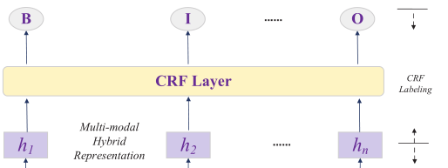


Method

Slide 8
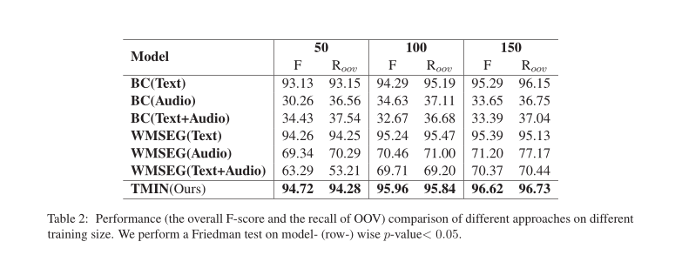
Experiments

Slide 9
Thank you!

